Slide 1
Stock Market Prediction Using Ensemble of Graph Theory, Machine Learning and Deep Learning Models
Muhammad Khubayeeb Kabir - 19101168
Anika Nahian Binte Kabir - 18101249
Mayesha Monjur - 18101411
Group #13

Slide 2
Related Work
Machine Learning
Deep Learning
Statistical Models
Approach taken in this paper:
Machine Learning
Deep Learning

Slide 3
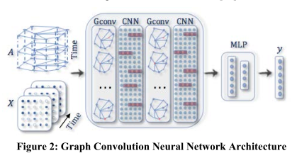
Architecture
Correlation-based relationship
Causation-based relationship
Spatio-temporal relationship

Slide 4
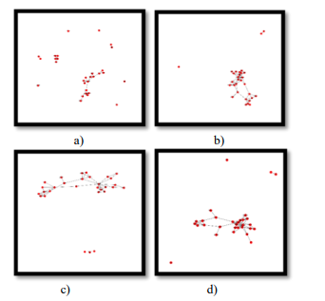
Graph Convolutional Network
Train-test-split
Hyperparameters- 10 epochs and lr - 0.001
4 GCNs:
-pearson correlation -Kendall Correlation
-spearman correlation’ -Causation

Slide 5
Graph-Based Linear Models and ARIMA
Single model
Composite Model
22-column feature vector was given as input
Output: 1D
Autoregressive Integrated Moving Average:

Slide 6
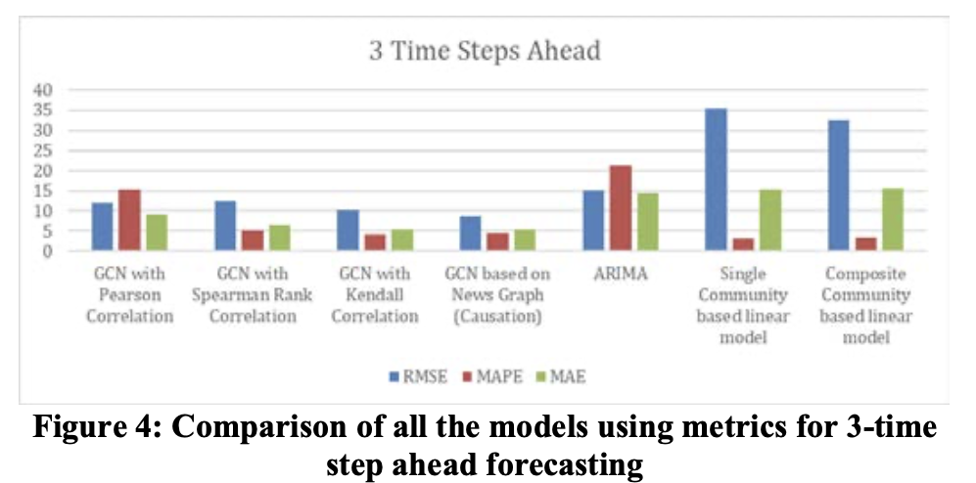
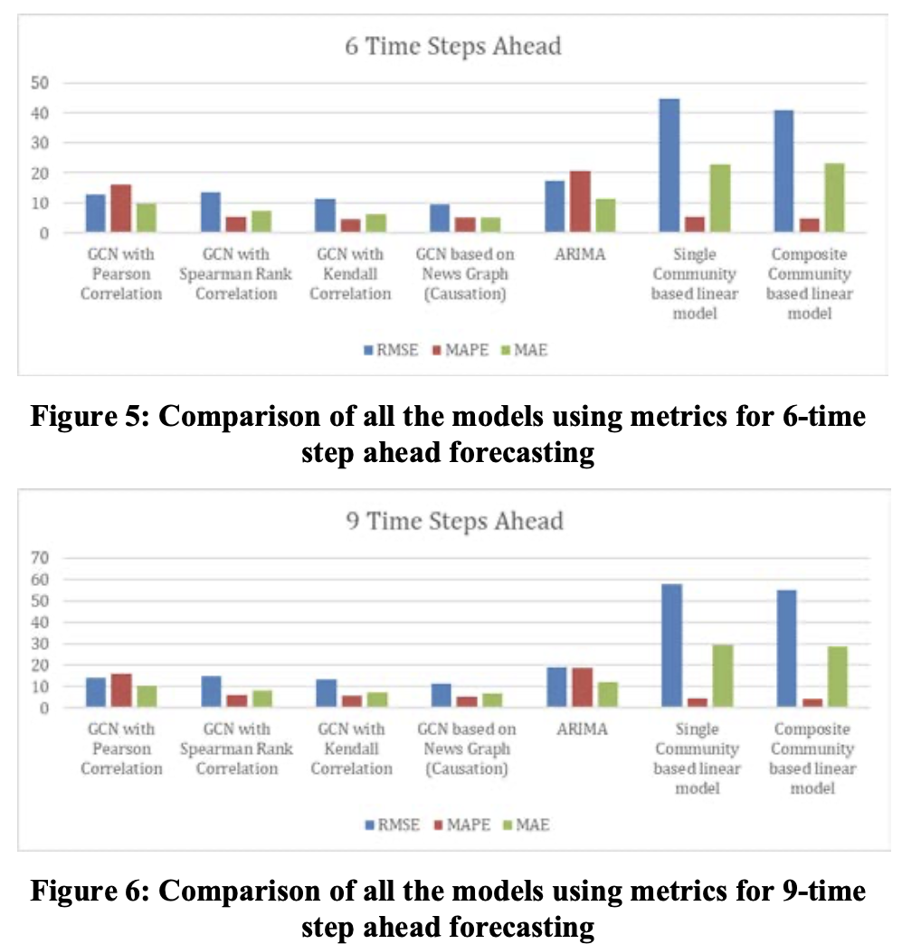
Results
Best Performing Model — GCM based on graph constructed from new co-mentions.
GCN model with Kendall tau correlation performs well
GCN models perform well in general than statistical method for time series forecasting

Slide 7
Future Work
Graph structure holds richer information and it can be leveraged in other machine learning problems like supervised and unsupervised classification.
Spatio-temporal GCN model for forecasting is not tied to socks and can be used in any generic time series prediction in the presence of graph representation.
The results of a more complex network(graph) can be studied.
The performance of GCN on a more generic time series forecasting can be measured.

